Slide 1
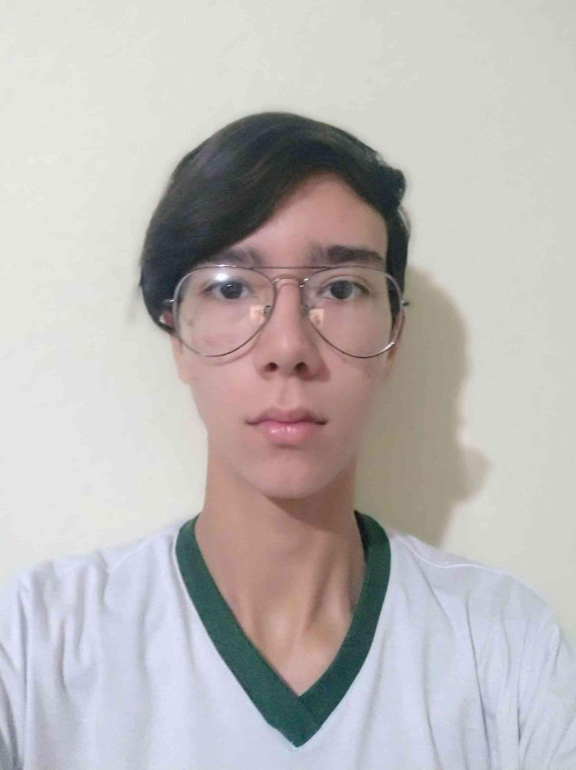
Nome: Rafael August Otto
Turma: 1INFO1
Matrícula: 2024311879
E-mail: rafael.august.otto.ifc@gmail.com
Linkedin: linkedin.com/in/rafael-august-otto-3809282b7
Lattes:http://lattes.cnpq.br/7909957241199998
Github: https://github.com/rafael-otto

